Slide 1


ASANSOL ENGINEERING COLLEGE
TOPIC: Breast Cancer Classification Project

Slide 2
Participants
TEAM LEADER: Moulina Panday
TEAM MEMBERS:
1. Arko Naha
2. Priyasis Chakraborty
3. Anubhav Sarkar

Slide 3
Models Used:
Random Forest
Logistic Regression
K- Nearest Neighbour
Support Vector Machine
Decision Tree
Here we use 5 models, namely:
1. Random forest
2. Logistic Regression
3. K-Nearest Neighbor
4. Support Vector Machine
5. Decision Tree

Slide 4
Evaluation Table
Model Name | Accuracy |  | Score | Precision |  | Recall |  | F1 |  | Support
 | In decimal | In %
 |  |  | M(1) | M(1) | B(0) | M(1) | B(0) | M(1) | B(0) | M(1) | B(0)
Random Forest | 0.9561 | 95.61 | 0.9978 | 0.97 | 0.95 | 0.90 | 0.99 | 0.94 | 0.97 | 42 | 72
Logistic Regression | 0.9736 | 97.37 | 0.9912 | 0.98 | 0.97 | 0.95 | 0.99 | 0.96 | 0.98 | 42 | 72
K-nearest neighbour | 0.9473 | 94.74 | 0.9824 | 0.97 | 0.93 | 0.88 | 0.99 | 0.93 | 0.96 | 42 | 72
Support Vector Machine | 0.9649 | 96.49 | 0.9868 | 0.95 | 0.97 | 0.95 | 0.97 | 0.95 | 0.97 | 42 | 72
Decision Tree | 0.9210 | 92.11 | 1.0 | 0.88 | 0.94 | 0.90 | 0.93 | 0.89 | 0.94 | 42 | 72

Slide 5
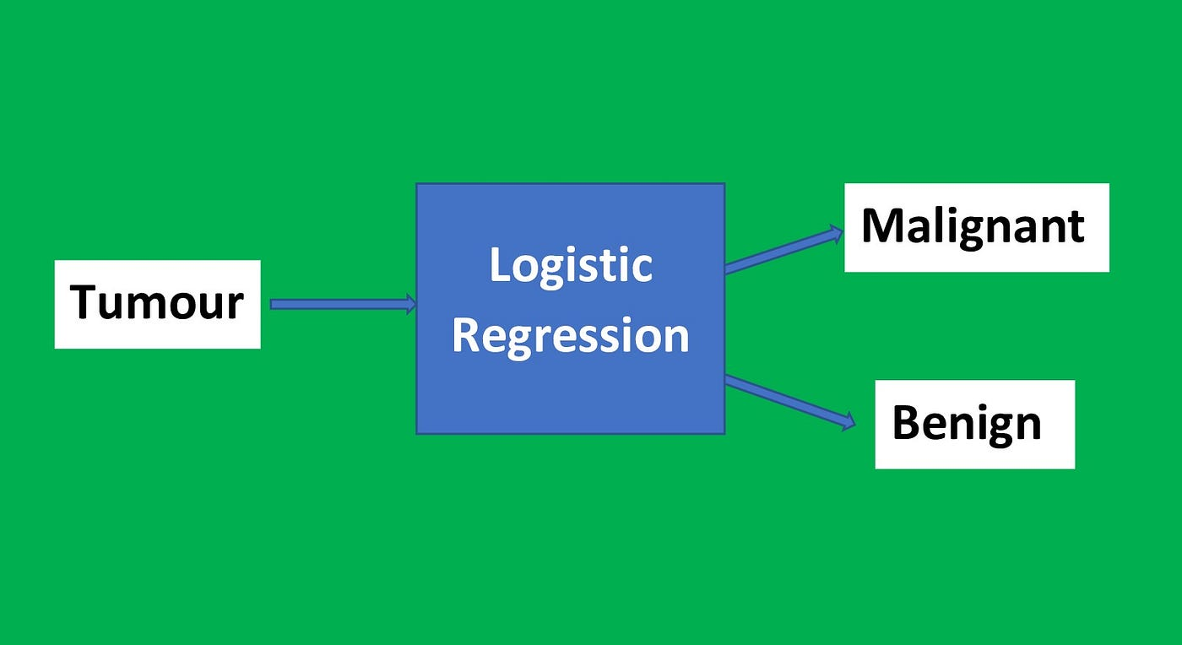
Conclusion:
From the above evaluation table, we see that logistic regression comes up with highest accuracy of 97% and hence fits our model the best.

